Slide 1
AWS CloudFormation
Lecturer: Ngo Huy Bien
Software Engineering Department
Faculty of Information Technology
University of Science
Ho Chi Minh City, Vietnam
nhbien@fit.hcmus.edu.vn

Slide 2

Objectives

Slide 3

Contents

Slide 4

References
Mark Wilkins (2019). Learning Amazon Web Services (AWS). Addison-Wesley Professional.

Slide 5
AWS CloudFormation
https://aws.amazon.com/cloudformation/
AWS CloudFormation lets you model, provision, and manage AWS and third-party resources by treating infrastructure as code.

Slide 6
Why CloudFormation?
Automate, test, and deploy infrastructure templates with continuous integration and delivery (CI/CD) automations.
Define an Amazon Virtual Private Cloud (VPC) subnet or provisioning services like AWS OpsWorks or Amazon Elastic Container Service (ECS) with ease.

Slide 7
CloudFormation Templates [1]
Each CloudFormation template is a text file that follows either JSON or YAML formatting standards.
CloudFormation templates can utilize multiple sections; however, the only mandated section that must be present is Resources.
AWSTemplateFormatVersion: "2010-09-09"
Description: EC2 instance
Resources:
EC2Instance:
Type: AWS::EC2::Instance
Properties:
ImageId: ami-008fe2fc65df48dac

Slide 8
CloudFormation Stacks
To provision resources from a template, you must specify a stack name that's unique within your account.
A stack is a container that organizes the resources described in the template.
The purpose of a stack is to collectively manage related resources.
If you delete a stack, CloudFormation automatically deletes all the resources in it.

Slide 9
CloudFormation vs. the AWS CLI
You can script AWS CLI commands to create resources fast and automatically, but those resources won't be kept in a stack.
When you're using the AWS CLI, you can't update your resources as easily as you can with CloudFormation.
With CloudFormation, you simply adjust the template or parameters to change your resources, and CloudFormation figures out how to perform the changes.
With the AWS CLI, it's up to you to understand how to change each resource and to ensure that a change you make to one resource doesn't break another.

Slide 10
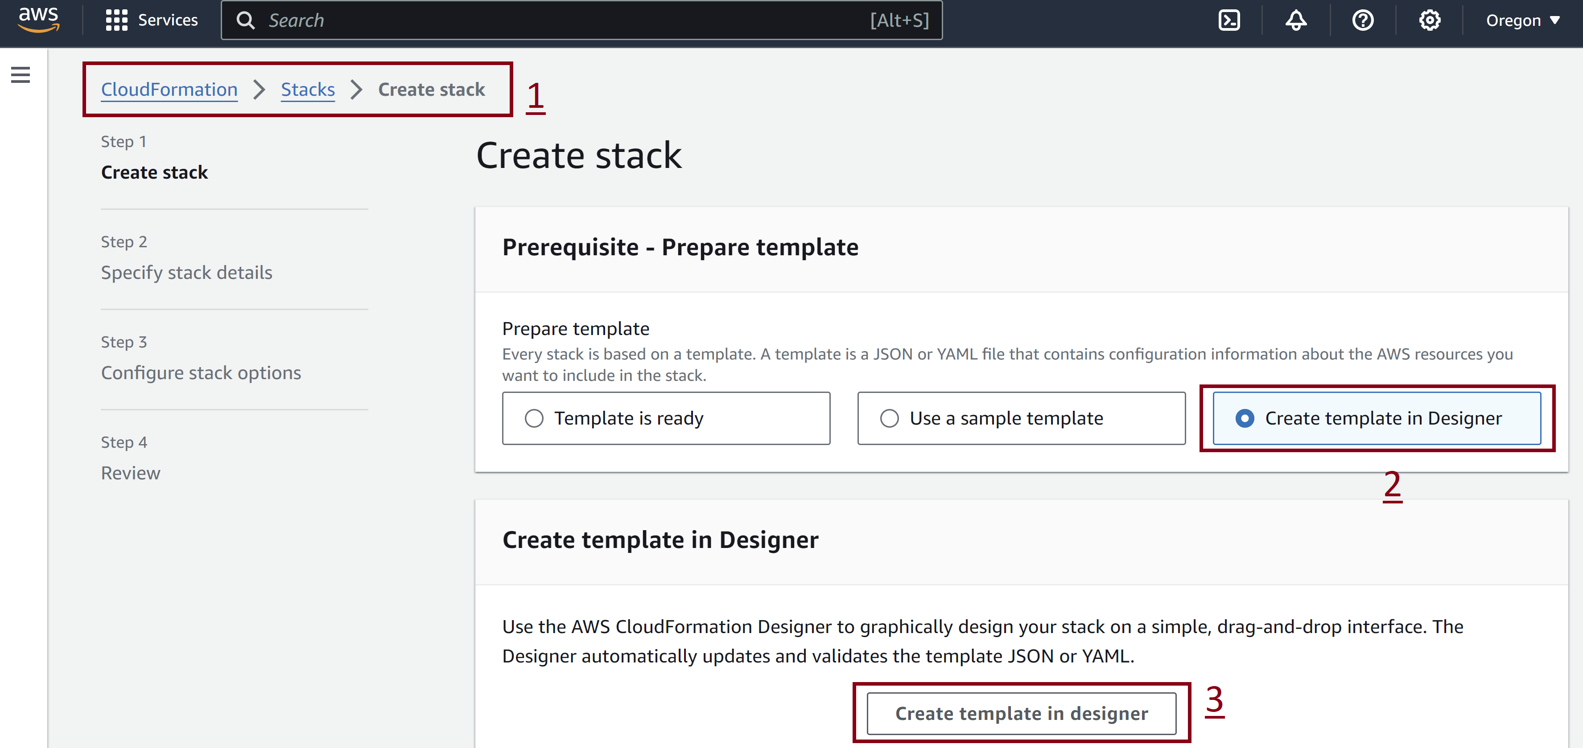
1. Open CloudFormation Designer

Slide 11
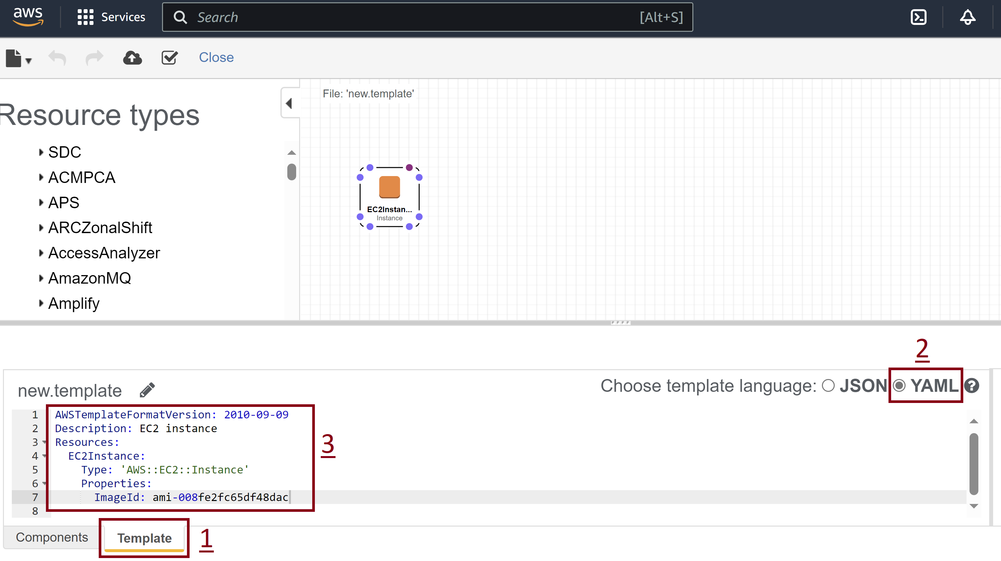
2. Open CloudFormation Designer

Slide 12
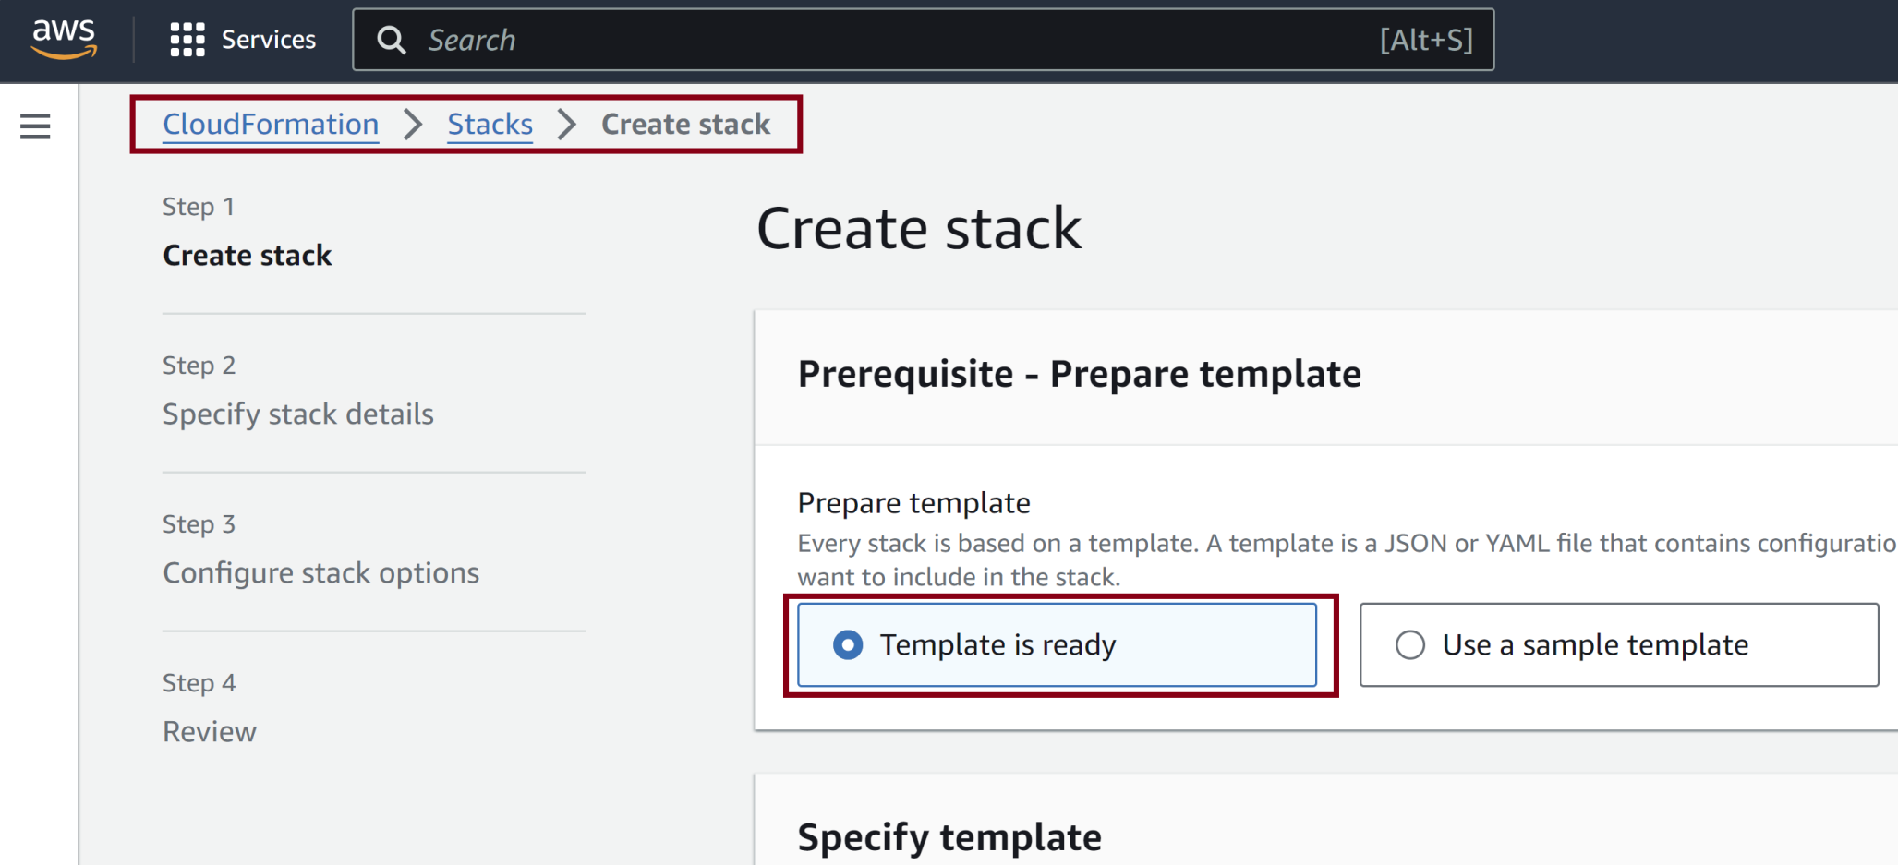
3. Create a Stack

Slide 13
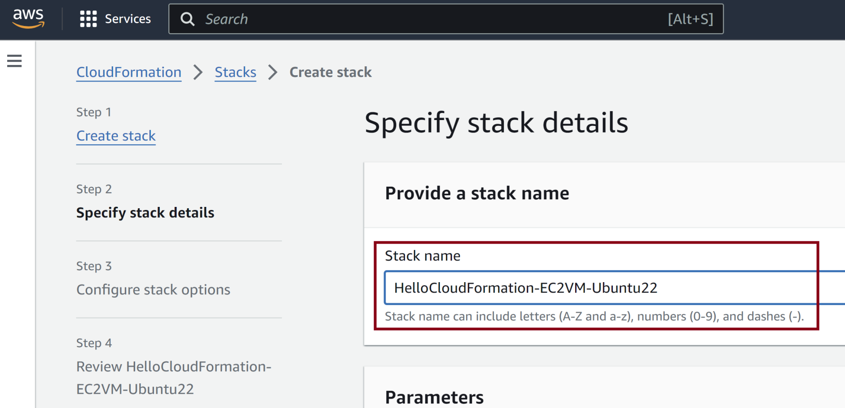
4. Enter Stack Name

Slide 14
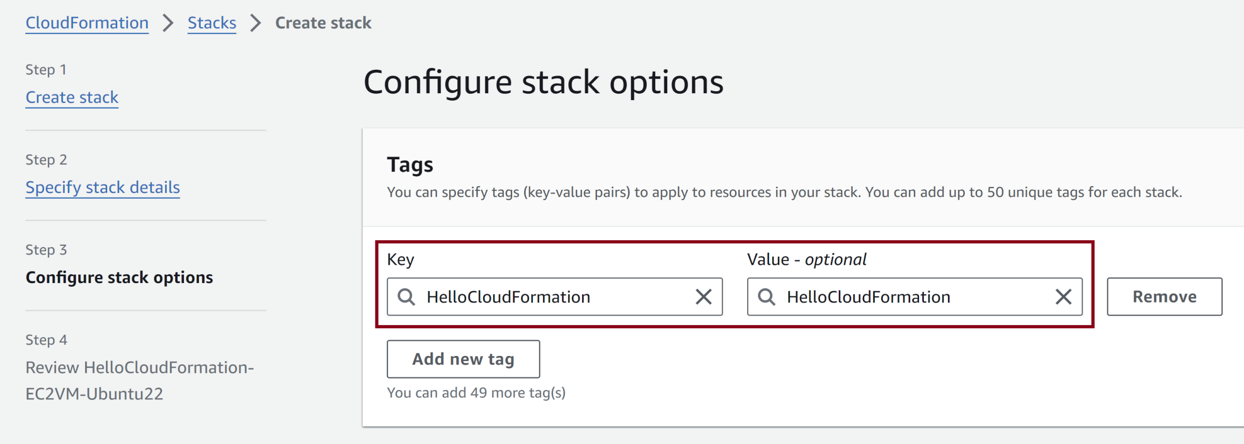
5. Configure Stack Options

Slide 15
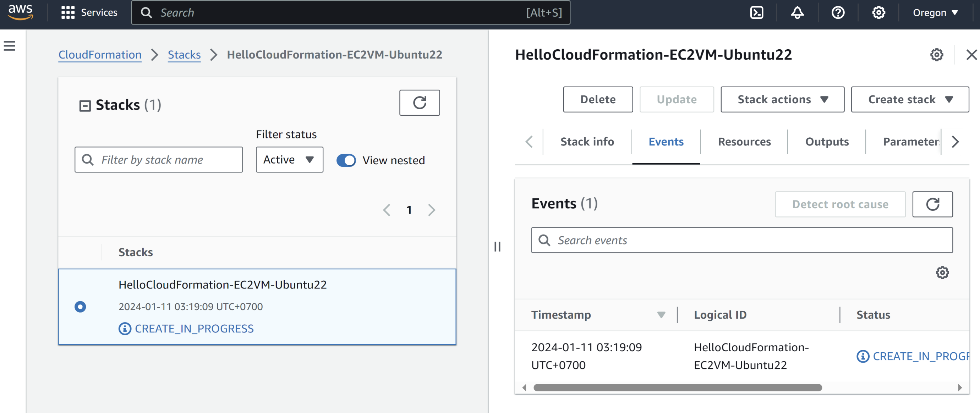
6. Review In-Progress Status

Slide 16
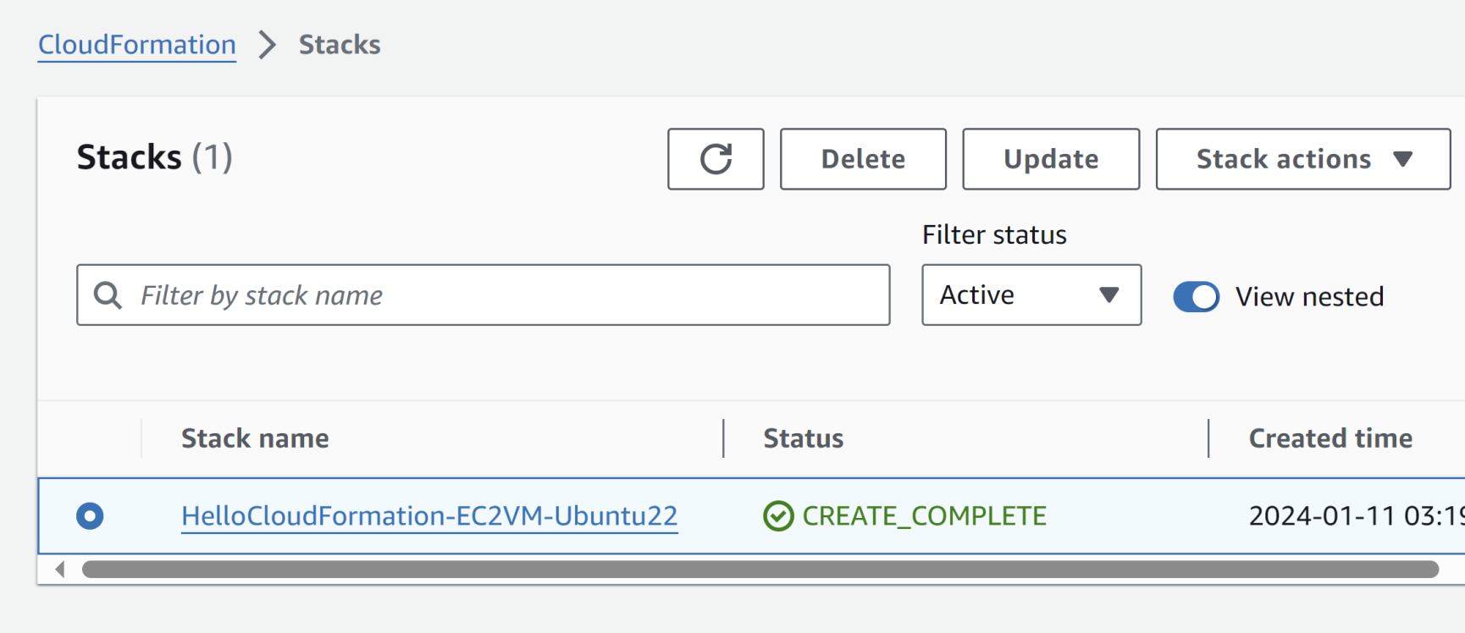
7. Review Complete Status

Slide 17
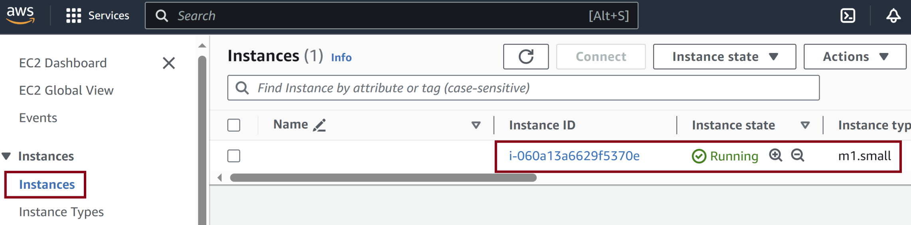
8. Review EC2 Virtual Machine

Slide 18
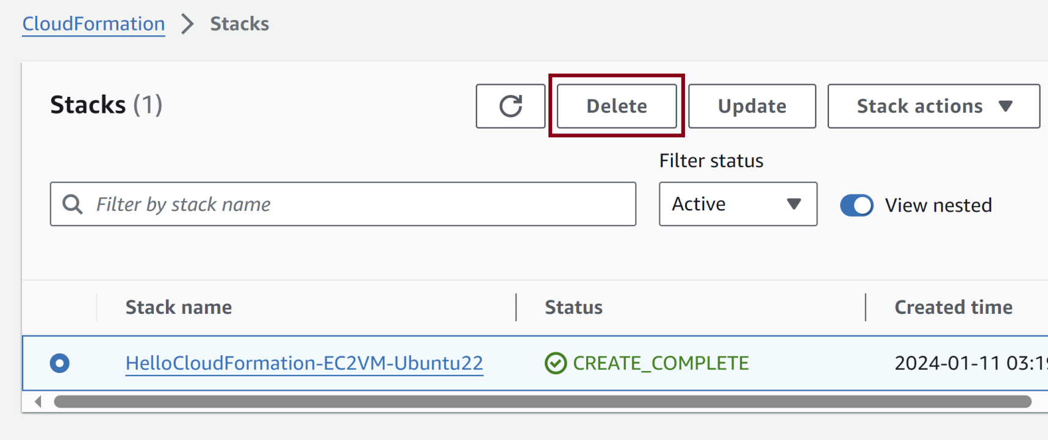
9. Delete Stack

Slide 19
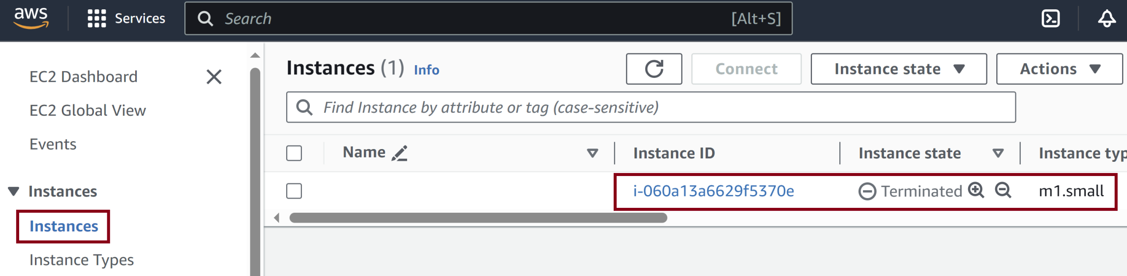
10. Review EC2 VM Deletion

Slide 20


Slide 21
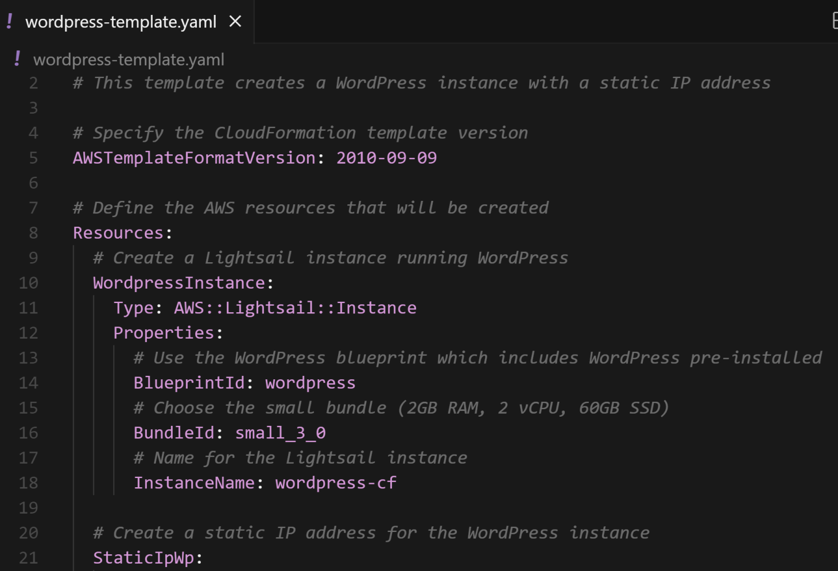
1. Prepare a Lightsail Template

Slide 22
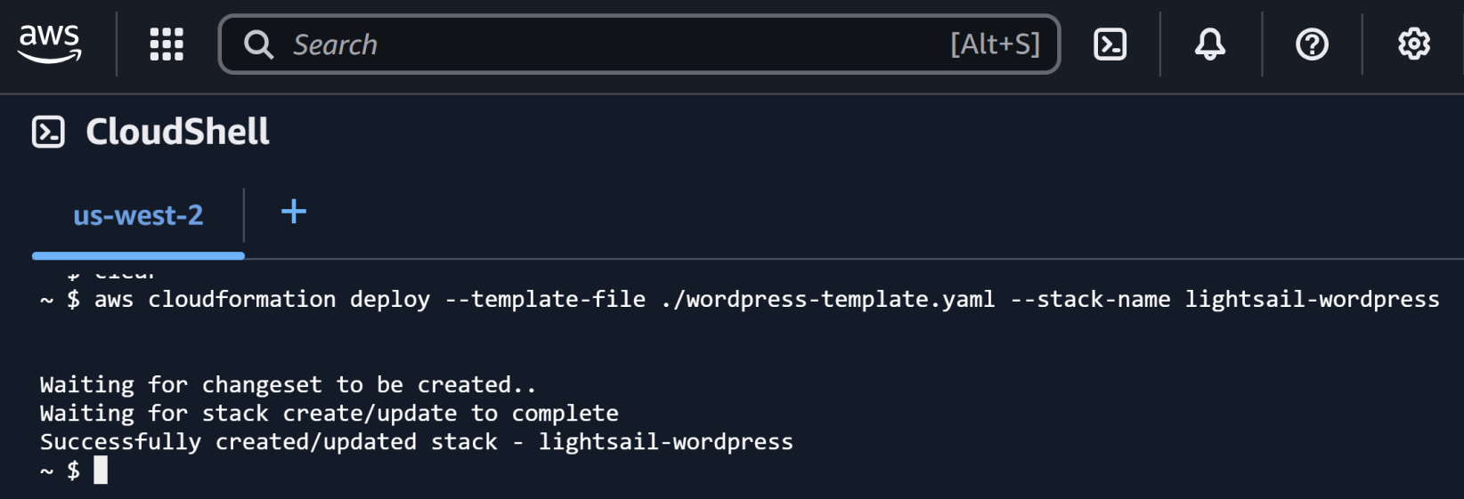
2. Deploy the Template
aws cloudformation deploy --template-file ./wordpress-template.yaml --stack-name lightsail-wordpress

Slide 23
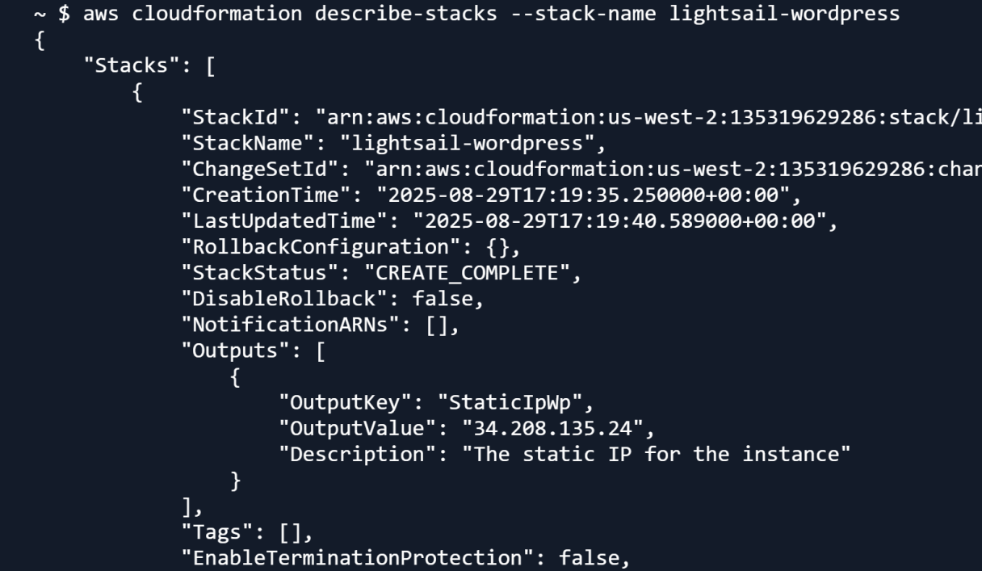
3. Retrieve IP
aws cloudformation describe-stacks --stack-name lightsail-wordpress

Slide 24
4. Delete Everything
aws cloudformation list-stacks
aws cloudformation delete-stack --stack-name lightsail-wordpress --deletion-mode FORCE_DELETE_STACK

Slide 26
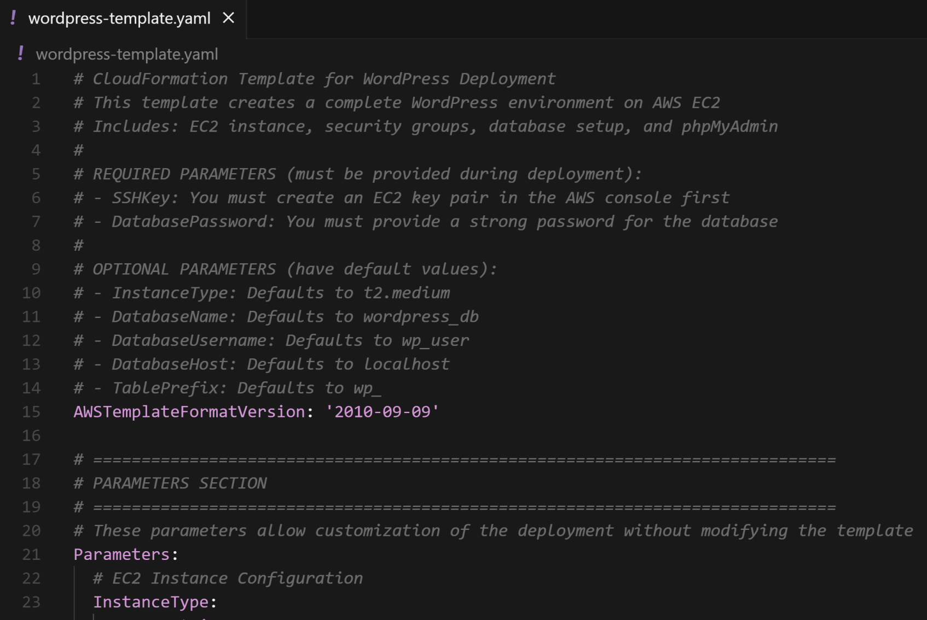
1. Prepare an EC2 Template

Slide 27
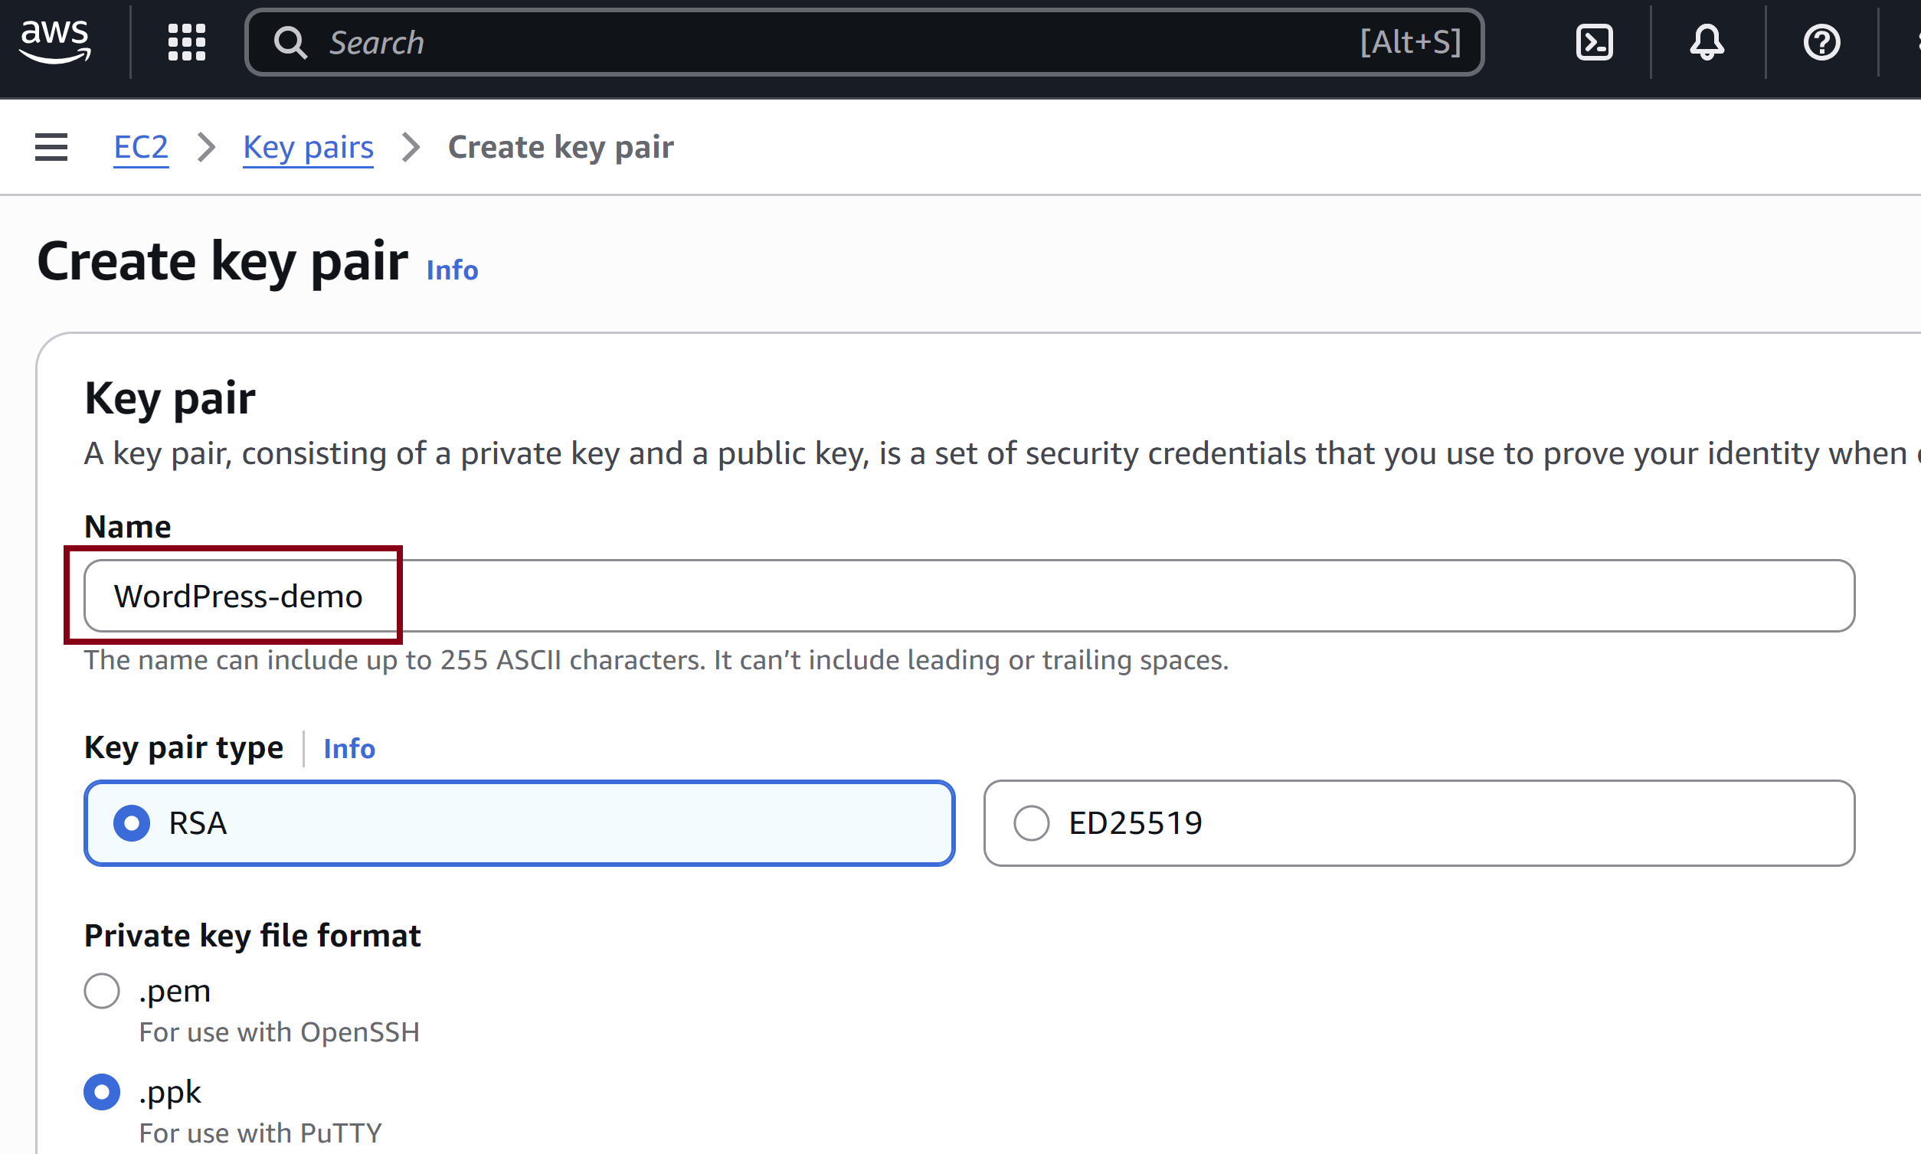
2. Create a Key Pair

Slide 28
3. Deploy the Template
aws cloudformation deploy --template-file ./wordpress-template.yaml --stack-name wordpress-demo
aws cloudformation list-stacks
aws cloudformation describe-stack-events --stack-name wordpress-demo

Slide 29
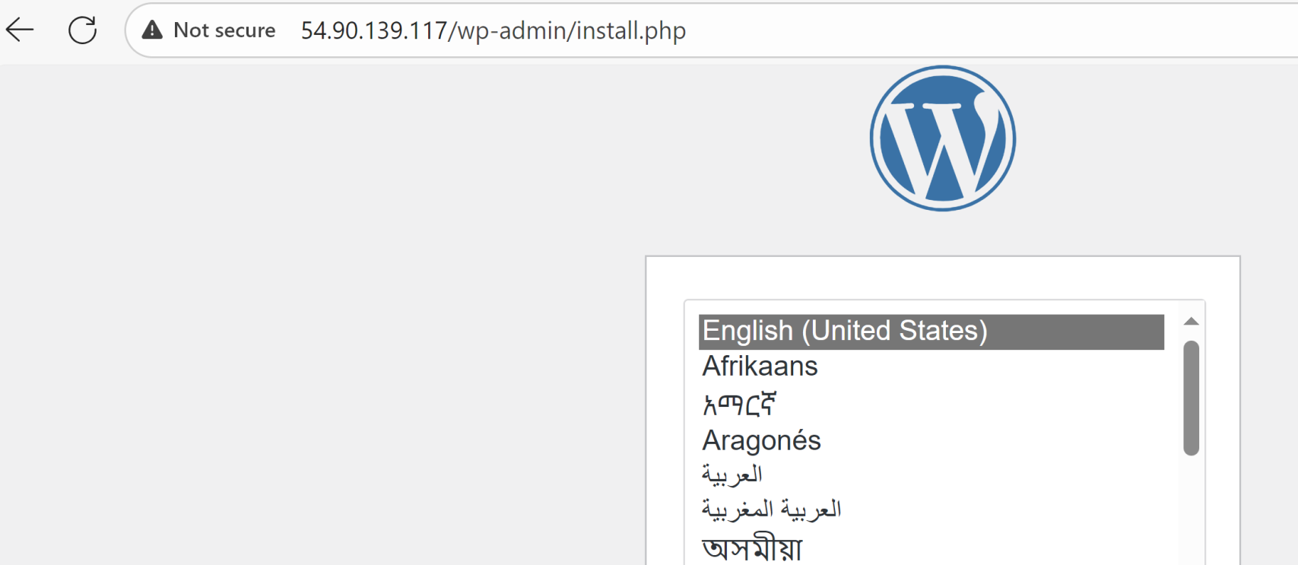
4. Access the WordPress Instance
http://54.90.139.117/
(Without HTTPS)

Slide 30
5. Delete the Stack
aws cloudformation delete-stack --stack-name wordpress-demo

